Slide 1
Developing a CNN for MNIST handwritten digit classification
By: Anurag Tripathi (A12405117001)

Slide 2
Contents
Convolutional Neural Network (CNN)
MNIST
Deep Learning
Image Classification
Introduction: MNIST Handwritten Digit Classification Dataset
Steps to Develop a Baseline Model

Slide 3
Convolutional Neural Network (CNN)
A convolutional neural network (CNN, or ConvNet) is a class of deep neural networks, most commonly applied to analyzing visual imagery.
It is a Deep Learning algorithm which can take in an input image, assign importance (learnable weights and biases) to various aspects/objects in the image and be able to differentiate one from the other.
The pre-processing required in a CNN is much lower as compared to other classification algorithms. While in primitive methods filters are hand-engineered, with enough training, CNN have the ability to learn these characteristics.

Slide 4
MIXED NATIONAL Institute of Standards and technology (MNIST)
The MNIST database is a large database of handwritten digits that is commonly used for training various image processing systems.
The database is also widely used for training and testing in the field of machine learning.
The MNIST database contains 60,000 training images and 10,000 testing images.
The dataset consists of pair, “handwritten digit image” and “label”. Digit ranges from 0 to 9, meaning 10 patterns in total.

Slide 5
Deep learning
Deep learning is an artificial intelligence function that imitates the workings of the human brain in processing data and creating patterns for use in decision making.
Deep learning is a subset of machine learning in artificial intelligence (AI) that has capability of learning unsupervised form of data that is unstructured or unlabeled.
Also known as deep neural learning or deep neural network.

Slide 6
Introduction: MNIST Handwritten Digit Classification Dataset
It is a dataset of 60,000 small square 28×28 pixel grayscale images of handwritten single digits between 0 and 9.
The task is to classify a given image of a handwritten digit into one of 10 classes representing integer values from 0 to 9, inclusively.
It is a widely used and deeply understood dataset and, for the most part, is “solved.” Top-performing models are deep learning convolutional neural networks that achieve a classification accuracy of above 99%, with an error rate between 0.4 %and 0.2% on the hold out test dataset.

Slide 7
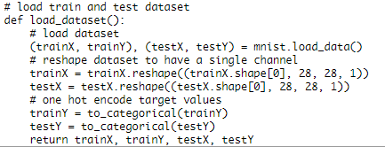
Steps to Develop a Baseline Model
1. Load Data Set
We can load the images and reshape the data arrays to have a single color channel and use a one hot encoding for the class element of each sample, transforming the integer into a 10 element binary vector with a 1 for the index of the class value, and 0 values for all other classes.

Slide 8
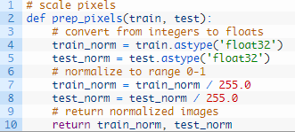
2. Prepare Pixel Data
The pixel values for each image in the dataset are unsigned integers in the range between black and white, or 0 and 255 and we some scaling will be required. A good starting point is to normalize the pixel values of grayscale images, e.g. rescale them to the range [0,1]. This involves first converting the data type from unsigned integers to floats, then dividing the pixel values by the maximum value. The prep_pixels() function below implements these behaviors and is provided with the pixel values for both the train and test datasets that will need to be scaled.

Slide 9
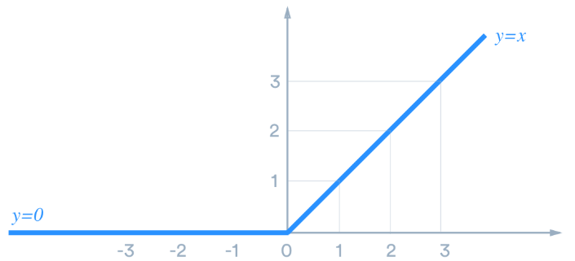
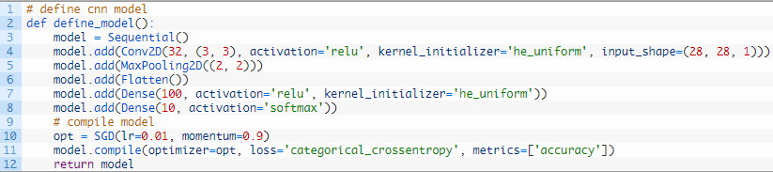
3. Define Model
Then comes the next task to define the model. All layers will use the ReLU activation function and the He weight initialization scheme, both best practices. ReLU stands for Rectified Linear Unit, and is a type of activation function. Mathematically, it is defined as y = max(0, x).

Slide 10
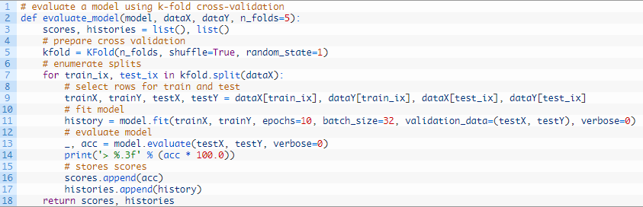
4. Evaluate Model
After the model is defined, we need to evaluate it.

Slide 11
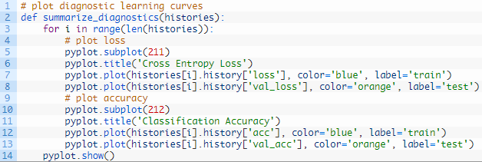
5. Present Result
Once the model has been evaluated, we can present the results.

